Slide 1
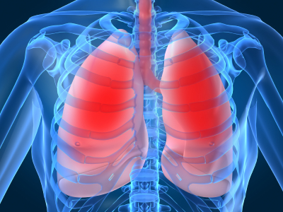
LECTURE NO (4)
Respiratory Physiology Bader Hassan
Lecturer Of Physiology
Gas exchange
Faculty Of Medicine Dept.Of Physiology

Slide 2
Gas exchange
Gas exchange in the lungs occurs between air in the alveoli & blood in the pulmonary capillaries.
O2 enters the blood from the alveoli & CO2 enters the alveoli from the blood.

Slide 3
Gas exchange
environment
alveoli
blood
Cells
O₂
O₂
O₂
air
O₂
mitochondria
CO₂
air
ventilation
CO₂
CO₂
CO₂
(2)
(1)

Slide 4
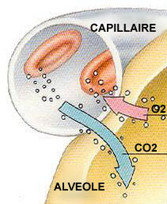

Slide 5
Gas exchange depend on the following factors:-
Pressure gradient:
Gases move passively from an area of higher pressure to an area of lower pressure.
The partial pressure of O2 (P O2) in the alveoli is higher than the P O2 in the blood, therefore O2 enters the blood.

Slide 6
The partial pressure of CO2 (P CO2) in the blood is higher than the P CO2 in the alveoli
Therefore CO2 enters the alveoli
PO2 : in the alveoli = 100 mmHg.
in the pulmonary capillaries (arteriolar end) = 40 mmHg.
in the pulmonary capillaries (venule end) = 100 mmHg
P CO2 in the alveoli = 40 mmHg.
in the pulmonary capillaries (arteriolar end) = 45 mmHg.
in the pulmonary capillaries (venule end) = 40 mmHg

Slide 7
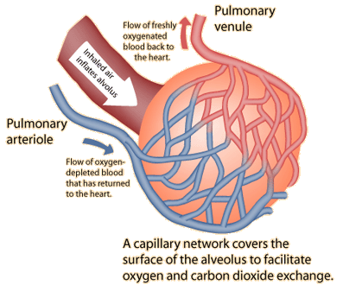

Slide 8
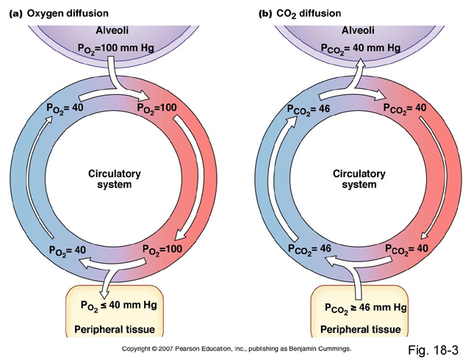

Slide 9
Gas exchange:alveoli and cells

Slide 10
Thickness of respiratory membrane:
Respiratory membrane consist of the following layers:
Fluid in the alveoli.
Alveolar wall.
Interstitial fluid.
Capillary wall.
Normal thickness = 0.5 micrometer.

Slide 11
Alveolar wall
Interstitial fluid
Fluid lining
the alveoli
Capillary wall
Components of the alveolar-capillary
(respiratory) membrane

Slide 12
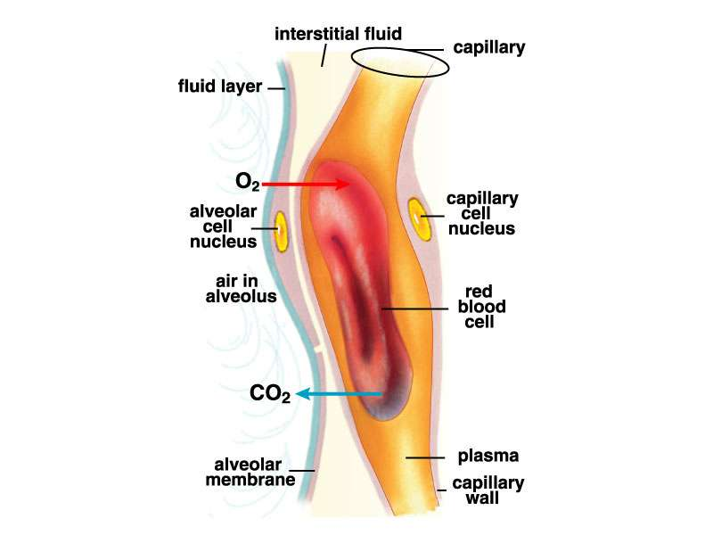

Slide 13
Gas exchange is inversely proportional to thickness of the respiratory membrane.
It is decreased when the thickness is increased e.g. due to lung fibrosis or pulmonary edema.

Slide 14
Respiratory membrane

Slide 15
Surface area:
It equals 70m2.
Gas exchange is directly proportional to the surface area.
Increased when the surface area is increased as in exercise.

Slide 16
Properties of the gas:-
The amount of gas that diffuses across the respiratory membrane depend on:
Solubility of the gas (direct relation).
Molecular weight of the gas (inverse relation).
The molecular weight of CO2 is larger than O2, however its diffusion is better because it has higher solubility.

Slide 17
CO2
O2
Pulmonary
capillaries
LA
RV
tissue
.

Slide 18


